Slide 1
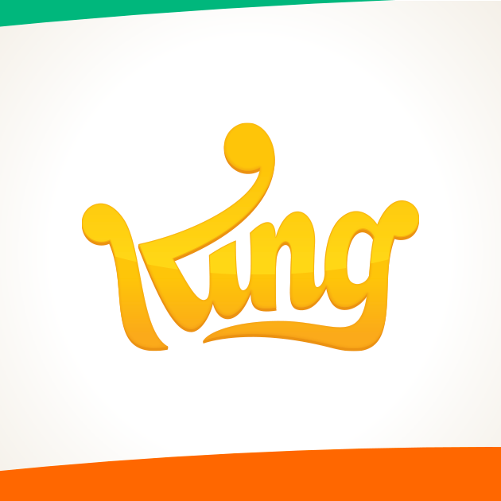
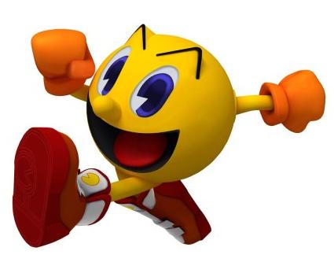
Introducing SuperPacman
Determining the factors to GET the optimal number of downloads

Slide 2

Acknowledgments
King is leading interactive entertainment company
King is launching a new game and need advice to find the best pricing method for google Play store
Institute of Data consultancy has analysed the market and has some recommendations
Thank you for appointing our consultancy

Slide 3
AGENDA
Context
Business Question
Google Playstore analysis
Project pipeline & Feature selection
Predictive model
Summary
Recommendations

Slide 4
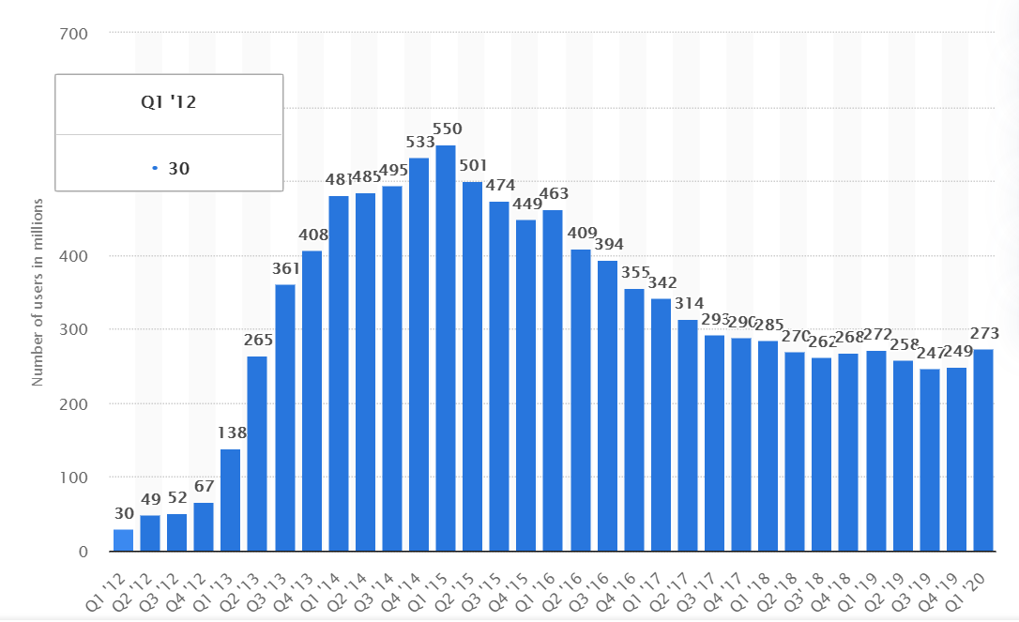
Context
The brief: King would like to know how to market their game in the Google play Store to maximise revenue
King's games aren’t for “gamers"; they're for everyone.
King released Candy Crush in 2012, one of the most financially successful games. It received 2.7 billion downloads within 5 years after its release.
King has 273 million monthly active users but numbers are decreasing. They monetise their games through in app-purchase.
Notes:
King's games aren't "by gamers, for gamers"; they're by business people, for everyone. They like to play it safe.
King gained fame in 2012 with Candy crush, still one of the most popular games despite the fast pace gaming environment.
King has 273 million monthly active users as of first quarter 2020 across web, social and mobile platforms but numbers are decreasing (see graph).
Candy Crush games made more than $1.5 billion in revenue from microtransactions in 2018 across iOS and Android, which is $4.2 million USD/day on average.

Slide 5

Business Question
What do King need to do in order to get the optimal number of downloads for SuperPacman.
They are especially interested to know if they can charge a fee to download their game

Slide 6
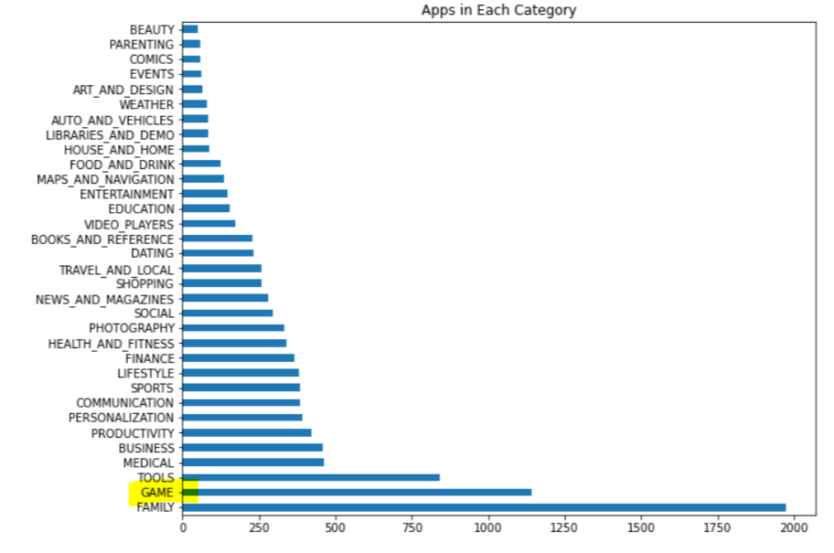
Google playstore Analysis - CATEGORIES
Data of 10k Play Store apps that have been downloaded
Games represents the category with the 2nd highest number of apps, approx. 10% of all the categories in the Google play store
Competition is fierce
Analysis on price, reviews, rating

Slide 7
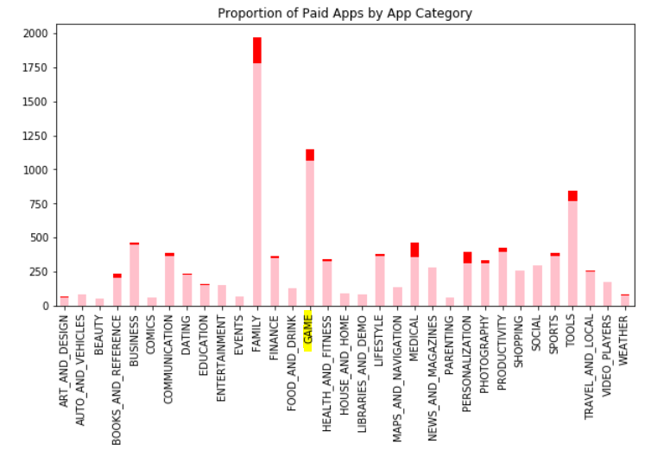

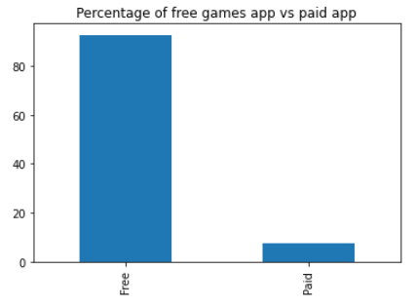
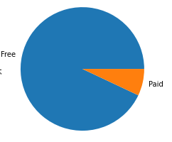
Google playstore Analysis – Price
Most of the apps are free across all categories
93% of games app are free

Slide 8
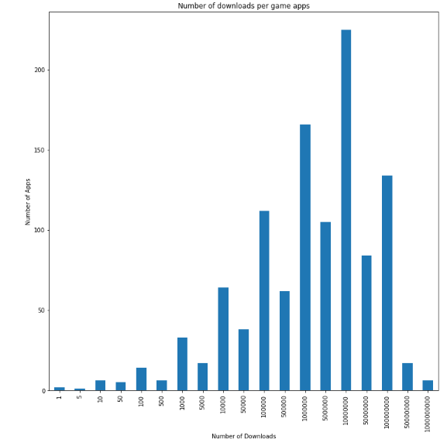
Google playstore Analysis – Price & downloads
On average, games app are downloaded:
10 million + times for free app
100 thousand times + for paid app
Cost is a huge barrier for download: 99% drop
It is clear that it is more strategic to keep the app free and have fees within the app.

Slide 9
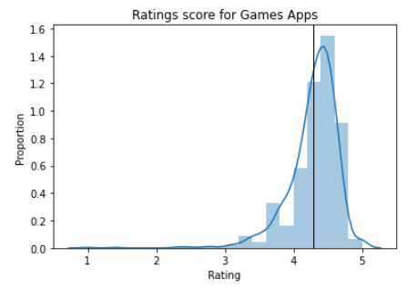
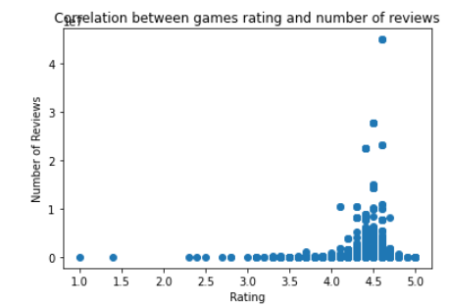
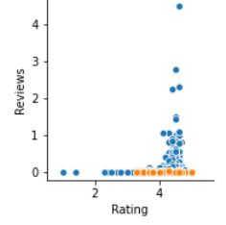

Google playstore Analysis – Reviews AND RATINGS
Average rating per game app = 4.3
It doesn’t vary much if they’re paid of free
Average number of reviews per game app =
approx. 1.5 Million reviews for free app
approx. 19 thousands reviews for paid app
Free apps with ratings over 4 tend to have the highest number of reviews
Most players write reviews when they love the game and when it’s free
Notes:
19174

Slide 10
Project pipeline
STAGE 01
Obtain Google Play Store Dataset from Kaggle and define the business question
Exploratory Data Analysis: How does the Playstore landscape look like for games
STAGE 03
Build predictive model: select the features impacting the number of downloads and build model
STAGE 02
STAGE 04
STAGE 05
Evaluate the model: Define which feature is the most critical
Recommend what factors need to be looked at to get optimal number of downloads

Slide 11
Feature selection
Target: Number of downloads
Ratings
Reviews
We’ve already seen that price is a huge factor and we don’t recommend to charge a fee, now focusing on ratings and reviews.

Slide 12
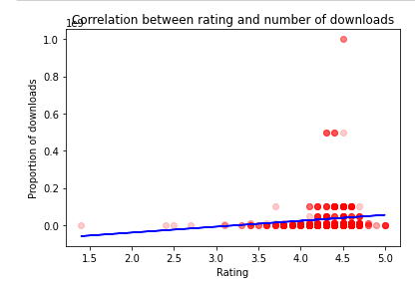
Predictive model
The higher the rating, the more chances users will download. If the rating is over 3.5, it’s likely users will download it. Need more data for accuracy.
The number of reviews is also obviously affected by number of downloads.

Slide 13
Summary of insights
 | Price | Ratings | Reviews | Downloads
Findings | The number of downloads drop by 99% if game app isn’t free | Needs a min of 3.5 rating to get downloads | Average number of reviews per game app is 1.5M | Average number of downloads per app is 10Million
Recommendations | Don’t charge, at least until you have enough positive reviews | Monitor and ensure rating is at least 3.5 (average 4.3) to get more downloads. Fully test before launching. | The more users love the game (and app is free) the higher chance they will write a review which impacts downloads too. | Once you have a few millions downloads, review and consider charging a small fee if in-app fees aren’t enough

Slide 14
Summary of project
Exploratory Data Analysis | Approach | Outcomes
From 10k apps, inc. 10% games app | Select the most important features to predict number of downloads | Keep the app free and only launch if ratings will be over 3.5
Features reviewed: price, rating, reviews | Price and ratings are the most important factors | Review pricing model at a later stage if in-app purchases aren’t generating enough

Slide 15

Next steps
First, monitor the rating of the app and ensure it’s above 3.5.
Second, encourage users to write positive reviews, perhaps doing marketing campaigns.
Third, keep the app free as it’s a huge barrier to get users to download. If the in-app purchase aren’t generating enough and the game had enough traction, we can review and analyse the pricing model further.

Slide 16

QUESTIONS?

Slide 17
Contact us
LinkedIn https://www.linkedin.com/in/perrinemignot/
Email mignotperrine@gmail.com
Phone 0450 446 859

